Slide 1
Regression Analysis
Regression Analysis in Practice
Nicoleta Serban, Ph.D.
Professor
School of Industrial and Systems Engineering
Customer Churn Analysis in the Telecom Sector

Slide 2

About This Lesson

Slide 3

Customer Churn Analysis
Customer Churn is of great interest in industries where revenues are heavily dependent on subscriptions.
Dataset: Customer data for 7,043 telecom clients, all located in CA, USA.
Data Source: IBM Business Analytics Community
Acknowledgement: This example was prepared with support from students in the Masters of Analytics program, including Jared Babcock, Rishi Bubna, Marta Bras, Aymee Garcia Lopez Gavilan, and Artur Bessa Cabral.

Slide 4
Response & Predicting Variables
Response variables:
Churn Value: 1 = the customer left the company. 0 = the customer remained with the company.
Predicting variables:
Demographics: 4 variables including customer’s gender (Gender), marital status (Partner) among others.
Location: 7 variables including customer’s primary residence ZIP Code (Zip Code), latitude (Latitude) among others.
Services: 15 variables including customer’s subscriptions to home phone (Phone Services), internet (Internet services), tech support (Tech Support) among others services.
Status: 6 variables including customer’s ID (CustomerID), reason for leaving the company (Churn Reason), customer’s lifetime value (CLTV) among others.

Slide 5
Objective and Methods
Predict which customers are likely to churn.
Logistic Regression
K Nearest Neighbors
Decision Tree
Random Forest

Slide 6
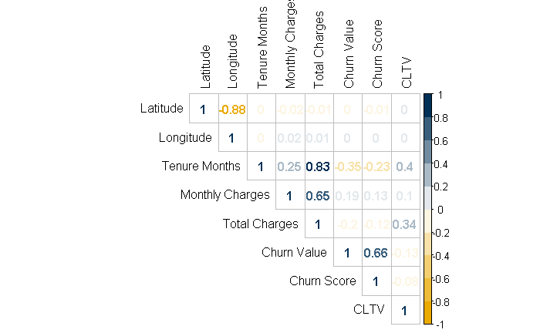
Exploratory Data Analysis in R
## Correlation among the numeric variables
# Select numerical variables
dat.num <- na.omit(dat[ , which(sapply(dat, is.numeric))])
# Create correlation matrix
corr <- cor(dat.num)
# Create correlation plot
col <- colorRampPalette(c(buzzgold,"white", gtblue))(10)
corrplot(corr, method = "number", type = "upper",
tl.col="black", col = col)
There appears to be strong correlation among some of the predicting variables.

Slide 7
Exploratory Data Analysis in R (cont’d)
## Relationship between binary response and numerical variables
par(mfrow=c(2,2))
boxplot(Total.Charges ~ Churn.Value, main="", xlab="Churn Value", ylab="Total Charges", col=c(techgold,buzzgold), data=dat)
boxplot(Monthly.Charges ~ Churn.Value, main="", xlab="Churn Value", ylab="Monthly Charges", col=c(techgold,buzzgold), data=dat)
boxplot(Tenure.Months ~ Churn.Value, main="", xlab="Churn Value", ylab="Tenure Months", col=c(techgold,buzzgold), data=dat)

Slide 8
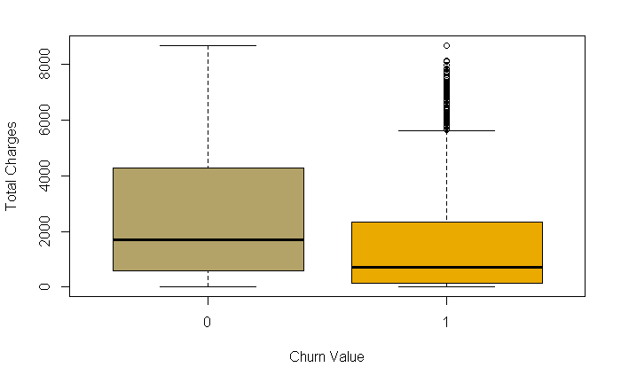
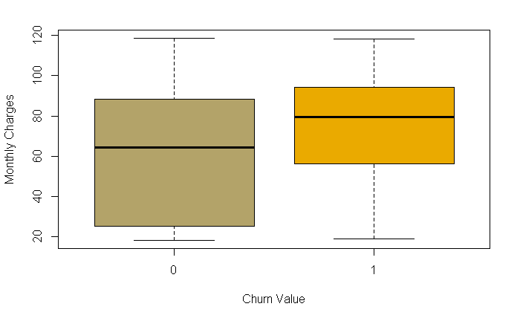
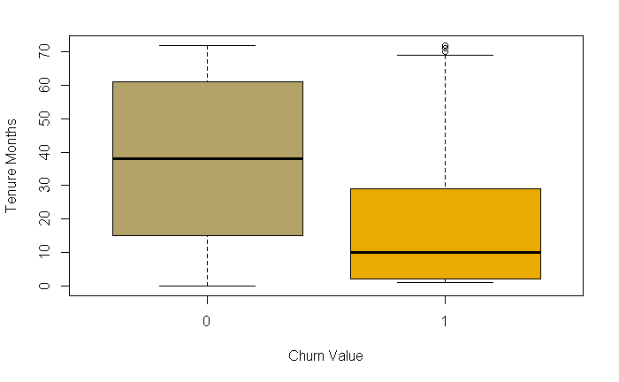
Exploratory Data Analysis in R (cont’d)
Customers that remain with the company appear to have higher total charges and tenure months but lower monthly charges than customers that have churned.

Slide 9
Exploratory Data Analysis in R (cont’d)
## Relationship between binary response and categorical variables
par(mfrow=c(1,3))
tb_obgender = xtabs(~dat$Churn.Value+ dat$Gender)
barplot(prop.table(tb_obgender),axes=T,space=0.3, cex.axis=1.5, cex.names=1.5,
xlab="Proportion of churn vs not churn",
horiz=T, col=c(gtblue,buzzgold),main="Churn by Gender")
tb_citizen = xtabs(~dat$Churn.Value+ dat$Senior.Citizen)
barplot(prop.table(tb_citizen),axes=T,space=0.3, cex.axis=1.5, cex.names=1.5,
xlab="Proportion of churn vs not churn",
horiz=T, col=c(gtblue,buzzgold),main="Churn by Senior citizen (Y/N)")
tb_Dependents = xtabs(~dat$Churn.Value+ dat$Dependents)
barplot(prop.table(tb_Dependents),axes=T,space=0.3,cex.axis=1.5, cex.names=1.5,
xlab="Proportion of churn vs not churn ",
horiz=T, col=c(gtblue,buzzgold),main="Churn by dependents (Y/N)",
legend.text = c("No", "Yes"))

Slide 10
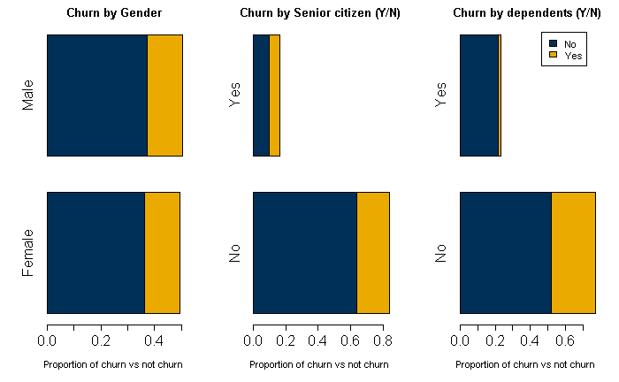
Exploratory Data Analysis in R (cont’d)
There seems to exist significant differences in the proportions for each group in the predicting variables Senior Citizen and Dependents.

Slide 11

Summary

